Slide 1
Object Diagram
What is Object Diagram
How to Draw Object Diagram
What is Object Diagram in UML?
Purpose of Object Diagram
Where to Use Object Diagram
Application of Object Diagram
Object Diagram at a Glance

Slide 2
What Is Object Diagram?
Object diagrams are derived from class diagrams so object diagrams are dependent upon class diagrams.
Object diagrams represent an instance of a class diagram. The basic concepts are similar for class diagrams and object diagrams. Object diagrams also represent the static view of a system but this static view is a snapshot of the system at a particular moment.
Object diagrams are used to render a set of objects and their relationships as an instance.

Slide 3
How to Draw Object Diagram?
Below are the steps to draw Object Diagram in UML:
Step 1)
Before drawing an object diagram, one should analyze all the objects inside the system.
Step 2)
The relations of the object must be known before creating the diagram.
Step 3)
Association between various objects must be cleared before.
Step 4)
An object should have a meaningful name that describes its functionality.
Step 5)
An object must be explored to analyze various functionalities of it.

Slide 4
Object Diagram Example
Husband
wife
Ronak
Age:-30
Marriage
Ronkeee
Age:-32
Child
Child
Child
Roman
Age:-10
Rojita
Age:-13
Raja
Age:-15

Slide 5
What is Object Diagram in UML?
An Object Diagram describes the instance of a class. It visualizes the particular functionality of a system. The difference between the class and object diagram is that the class diagram mainly represents the bird’s eye view of a system which is also referred to as an abstract view.
Objects are the real-world entities whose behavior is defined by the classes. Objects are used to represent the static view of an object-oriented system. We cannot define an object without its class. Object and class diagrams are somewhat similar.

Slide 6
Purpose Of Object Diagram
The purpose of a diagram should be understood clearly to implement it practically. The purposes of object diagrams are similar to class diagrams.
The difference is that a class diagram represents an abstract model consisting of classes and their relationships. However, an object diagram represents an instance at a particular moment, which is concrete in nature.
It means the object diagram is closer to the actual system behavior. The purpose is to capture the static view of a system at a particular moment.
The purpose of the object diagram can be summarized as
Forward and reverse engineering.
Object relationships of a system
Static view of an interaction.
Understand object behavior and their relationship from practical perspective

Slide 7
Application Of Object Diagram
Object diagrams play an essential role while generating a blueprint of an object-oriented system.
Object diagrams provide means of modeling the classes, data and other information as a set or a single unit.
It is used for analyzing the online or offline system. The functioning of a system can be visualized using object diagrams.

Slide 8
Where to Use Object Diagram
Object diagrams can be imagined as the snapshot of a running system at a particular moment. Let us consider an example of a running train
Now, if you take a snap of the running train then you will find a static picture of it having the following −
A particular state which is running.
A particular number of passengers. which will change if the snap is taken in a different time
Here, we can imagine the snap of the running train is an object having the above values. And this is true for any real-life simple or complex system.
In a nutshell, it can be said that object diagrams are used for −
Making the prototype of a system.
Reverse engineering.
Modeling complex data structures.
Understanding the system from practical perspective

Slide 9
Object Diagram at a Glance
An object diagram shows this relation between the instantiated classes and the defined class, and the relation between these objects in the system. They are be useful to explain smaller portions of your system, when your system class diagram is very complex, and also sometimes modeling recursive relationship in diagram.
The best way to illustrate what an object diagram look like is to show the object diagram derived from the corresponding class diagram

Slide 10
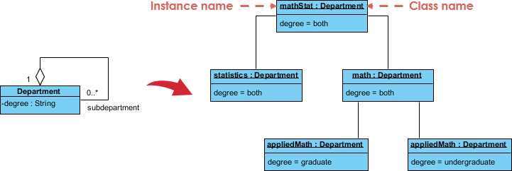
Object Diagram at a Glance Example

